Slide 1


Computer Architecture Spring 2020
Hamed Farbeh
farbeh@aut.ac.ir
Department of Computer Engineering
Amirkabir University of Technology
BASIC COMPUTER ORGANIZATION AND DESIGN

Slide 2
Outlines
• Instruction Codes
• Computer Registers
• Computer Instructions
• Timing and Control
• Instruction Cycle
• Memory Reference Instructions
• Input-Output and Interrupt
• Complete Computer Description
• Design of Basic Computer
• Design of Accumulator Logic
Computer Architecture-Spring 2020, AUT, Tehran, Iran

Slide 3
INTRODUCTION
Every different processor type has its own design (different registers, buses, microoperations, machine instructions, etc)
Modern processor is a very complex device
It contains
Many registers
Multiple arithmetic units, for both integer and floating point calculations
The ability to pipeline several consecutive instructions to speed execution
Etc.
Computer Architecture-Spring 2020, AUT, Tehran, Iran

Slide 4
INTRODUCTION
However, to understand how processors work, we will start with a simplified processor model
This is similar to what real processors were like ~25 years ago
M. Morris Mano introduces a simple processor model he calls the Basic Computer
We will use this to introduce processor organization and the relationship of the RTL model to the higher level computer processor
Computer Architecture-Spring 2020, AUT, Tehran, Iran

Slide 5
THE BASIC COMPUTER
The Basic Computer has two components, a processor and memory
The memory has 4096 words in it
4096 = 2¹², so it takes 12 bits to select a word in memory
Each word is 16 bits long
CPU
RAM
0
15
0
4095
Computer Architecture-Spring 2020, AUT, Tehran, Iran

Slide 6
INSTRUCTIONS
Program
A sequence of (machine) instructions
(Machine) Instruction
A group of bits that tell the computer to perform a specific operation (a sequence of micro-operation)
The instructions of a program, along with any needed data are stored in memory
The CPU reads the next instruction from memory
It is placed in an Instruction Register (IR)
Control circuitry in control unit then translates the instruction into the sequence of microoperations necessary to implement it
Computer Architecture-Spring 2020, AUT, Tehran, Iran

Slide 7
INSTRUCTION FORMAT
A computer instruction is often divided into two parts
An opcode (Operation Code) that specifies the operation for that instruction
An address that specifies the registers and/or locations in memory to use for that operation
In the Basic Computer, since the memory contains 4096 (= 2¹²) words, we needs 12 bit to specify which memory address this instruction will use
In the Basic Computer, bit 15 of the instruction specifies the addressing mode (0: direct addressing, 1: indirect addressing)
Since the memory words, and hence the instructions, are 16 bits long, that leaves 3 bits for the instruction’s opcode
Instruction Format
15
14
12
11
0
I
Opcode
Address
Addressing
mode
Computer Architecture-Spring 2020, AUT, Tehran, Iran

Slide 8

ADDRESSING MODES
The address field of an instruction can represent either
Direct address: the address in memory of the data to use (the address of the operand), or
Indirect address: the address in memory of the address in memory of the data to use
Effective Address (EA)
The address that can be directly used without modification to access an operand for a computation-type instruction, or as the target address for a branch-type instruction
Direct addressing
Indirect addressing
22
0
ADD
457
35
1
ADD
300
300
1350
457
Operand
1350
Operand
+
+
AC
AC
Computer Architecture-Spring 2020, AUT, Tehran, Iran

Slide 9
PROCESSOR REGISTERS
A processor has many registers to hold instructions, addresses, data, etc
The processor has a register, the Program Counter (PC) that holds the memory address of the next instruction to get
Since the memory in the Basic Computer only has 4096 locations, the PC only needs 12 bits
12-bit
PC
Computer Architecture-Spring 2020, AUT, Tehran, Iran

Slide 10
PROCESSOR REGISTERS
In a direct or indirect addressing, the processor needs to keep track of what locations in memory it is addressing
The Address Register (AR) is used for this
The AR is a 12-bit register in the Basic Computer
When an operand is found, using either direct or indirect addressing, it is placed in the Data Register (DR)
The processor then uses this value as data for its operation
The Basic Computer has a single general purpose register – the Accumulator (AC)
Computer Architecture-Spring 2020, AUT, Tehran, Iran

Slide 11
PROCESSOR REGISTERS
The significance of a general purpose register is that it can be referred to in instructions
e.g. load AC with the contents of a specific memory location; store the contents of AC into a specified memory location
Often a processor will need a scratch register to store intermediate results or other temporary data
In the Basic Computer this is the Temporary Register (TR)
Computer Architecture-Spring 2020, AUT, Tehran, Iran

Slide 12
PROCESSOR REGISTERS
The Basic Computer uses a very simple model of input/output (I/O) operations
Input devices are considered to send 8 bits of character data to the processor
The processor can send 8 bits of character data to output devices
The Input Register (INPR) holds an 8 bit character gotten from an input device
The Output Register (OUTR) holds an 8 bit character to be send to an output device
Computer Architecture-Spring 2020, AUT, Tehran, Iran

Slide 13
BASIC COMPUTER REGISTERS
11
0
PC
Memory
11
0
4096 x 16
AR
15
0
IR
CPU
15
0
15
0
TR
DR
7
0
7
0
15
0
OUTR
INPR
AC
List of BC Registers
DR 16 Data Register Holds memory operand
AR 12 Address Register Holds address for memory
AC 16 Accumulator Processor register
IR 16 Instruction Register Holds instruction code
PC 12 Program Counter Holds address of instruction
TR 16 Temporary Register Holds temporary data
INPR 8 Input Register Holds input character
OUTR 8 Output Register Holds output character
Computer Architecture-Spring 2020, AUT, Tehran, Iran

Slide 14
COMMON BUS SYSTEM
The registers in the Basic Computer are connected using a bus
This gives a savings in circuitry over complete connections between registers
Computer Architecture-Spring 2020, AUT, Tehran, Iran

Slide 15
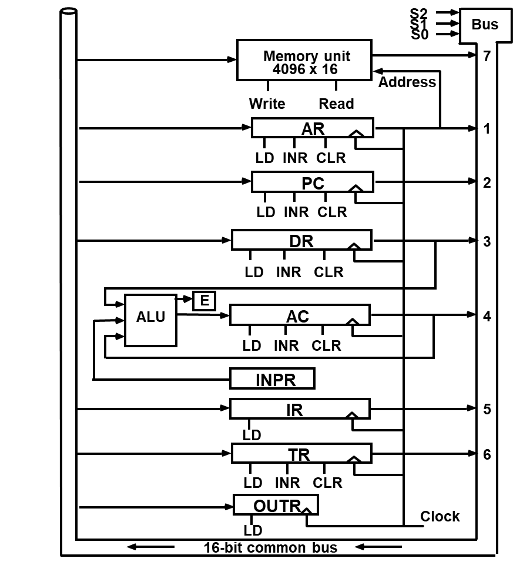
COMMON BUS SYSTEM
Computer Architecture-Spring 2020, AUT, Tehran, Iran

Slide 16
COMMON BUS SYSTEM
Read
INPR
Memory
4096 x 16
Write
Address
E
ALU
AC
L
I
C
L
I
C
L
L
I
C
DR
IR
L
I
C
PC
TR
AR
OUTR
LD
L
I
C
7
1
2
3
4
5
6
16-bit Common Bus
S₀
S₁
S₂
Computer Architecture-Spring 2020, AUT, Tehran, Iran

Slide 17
COMMON BUS SYSTEM
Three control lines, S₂, S₁, and S₀ control which register the bus selects as its input
Either one of the registers will have its load signal activated, or the memory will have its read signal activated
Will determine where the data from the bus gets loaded
The 12-bit registers, AR and PC, have 0’s loaded onto the bus in the high order 4 bit positions
When the 8-bit register OUTR is loaded from the bus, the data comes from the low order 8 bits on the bus
S₂ S₁ S₀ Register
0 0 0 x
0 0 1 AR
0 1 0 PC
0 1 1 DR
1 0 0 AC
1 0 1 IR
1 1 0 TR
1 1 1 Memory
Computer Architecture-Spring 2020, AUT, Tehran, Iran

Slide 18
to be continued
Computer Architecture-Spring 2020, AUT, Tehran, Iran

